Slide 1
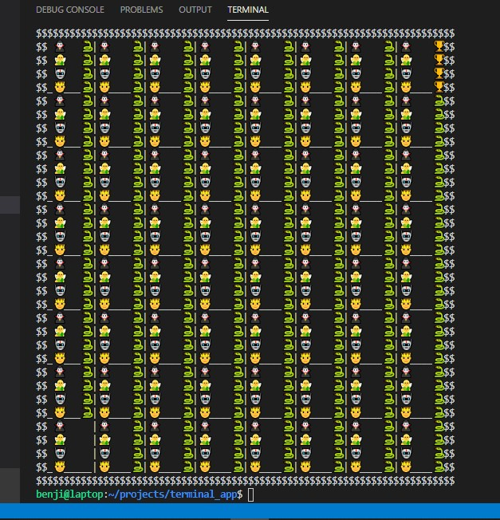
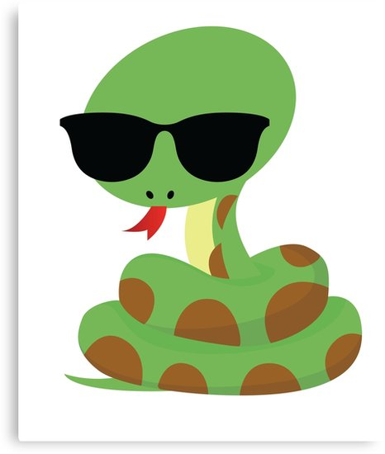

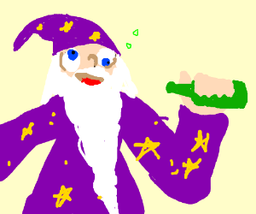
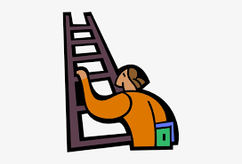
MAGIC SNAKES AND LADDERS
and the
drunk wizards

Slide 2
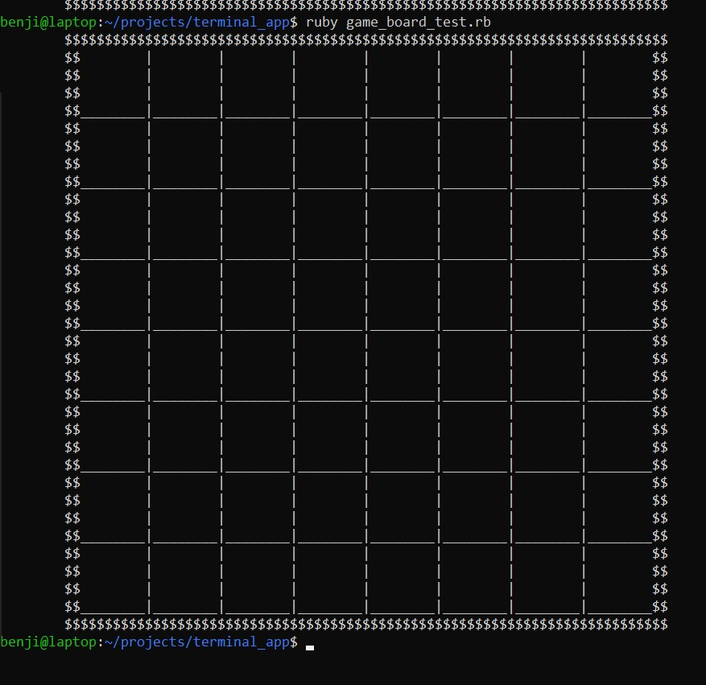
WALKTHROUGH
SNAKES
LADDERS
WIZARDS

Slide 3
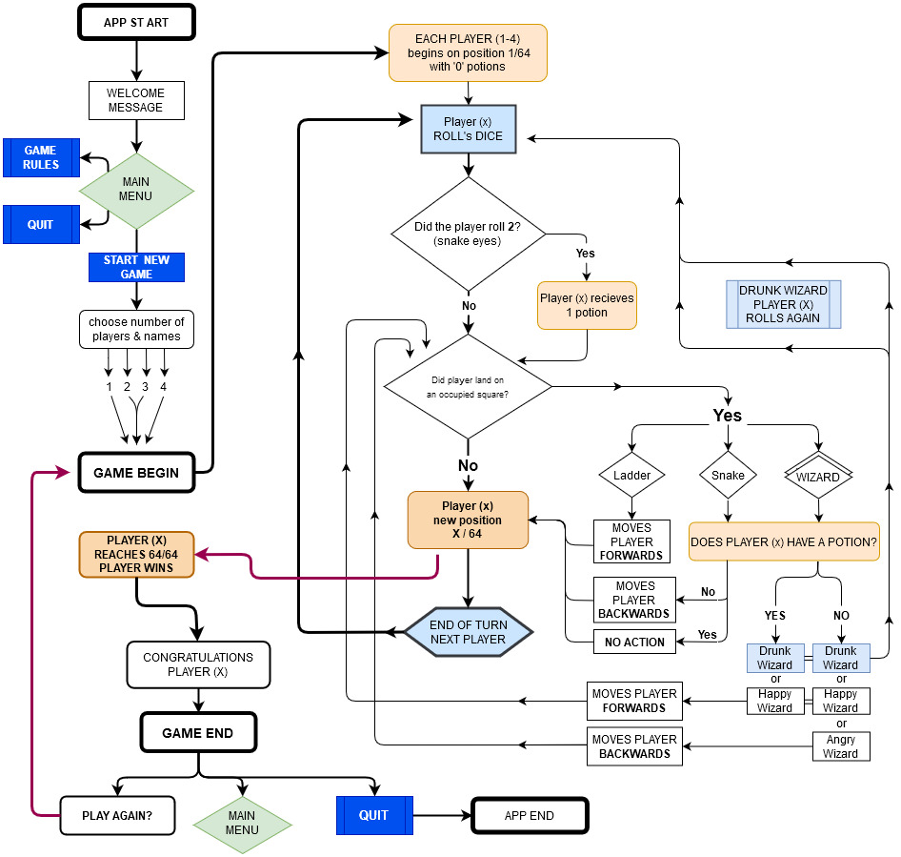
There was meant to be a main menu, and a few more features to the app.
But the core features made it! :)
Each player would take their turn... and roll the dice
If a player landed on snake they would have to go backwards
If a player landed on a ladder they would move forwards
If a player landed on a wizard... anything could happen
The first player to the end Wins..!!

Slide 4
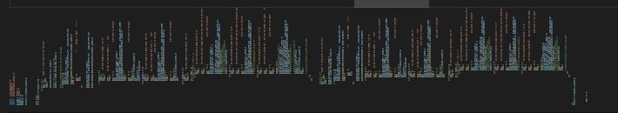
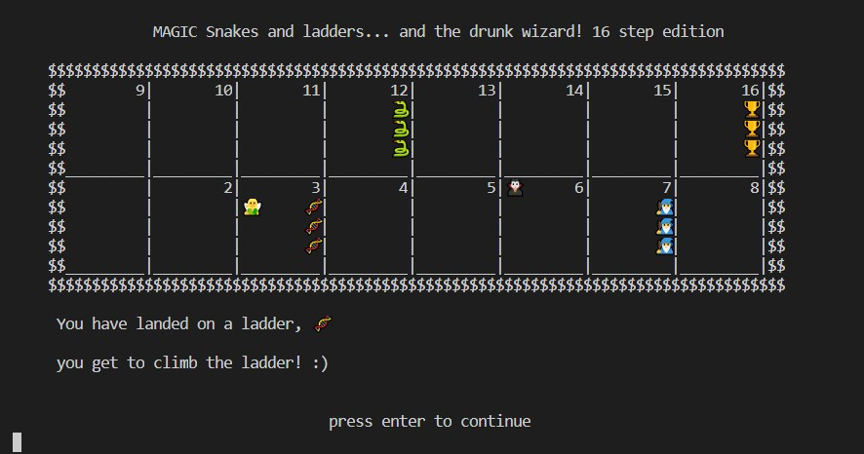
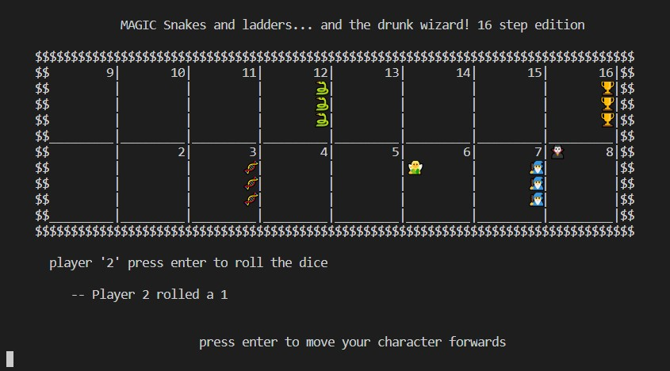
ThE final product
*the real snake
WIZARD ALERT!

Slide 5
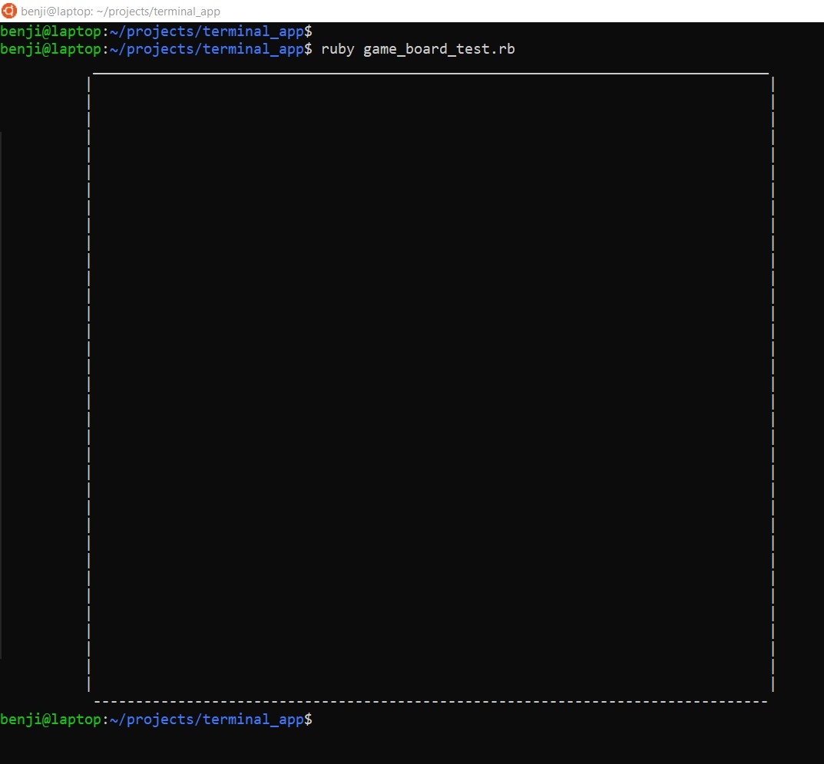
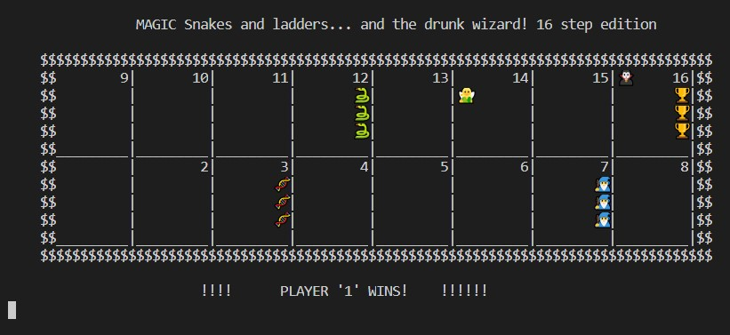
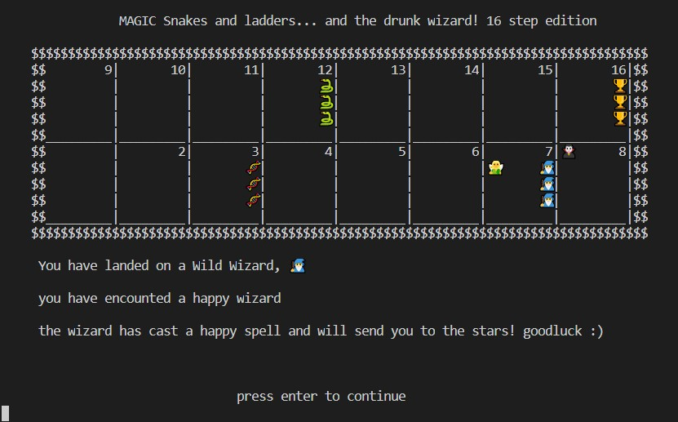
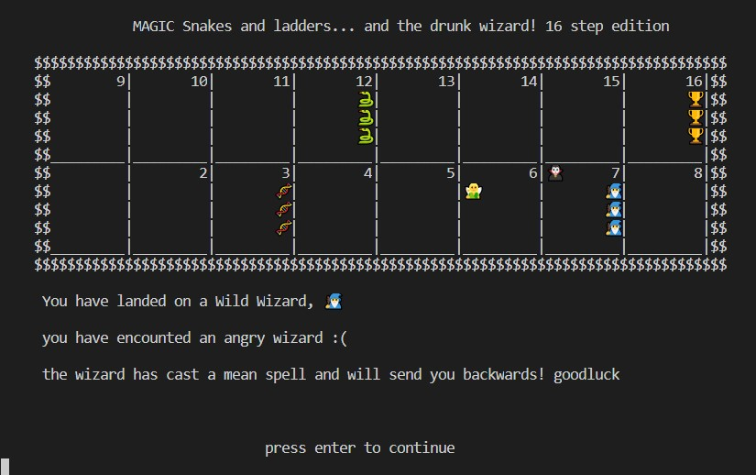

Slide 6
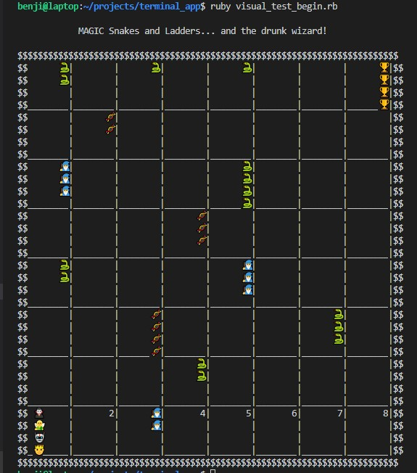
Original Idea:

Slide 7
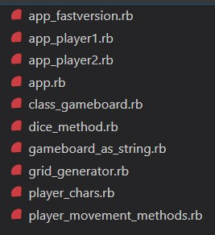
Command line arguments etc
File Structure
Normal game: app.rb
Fast game: appfastversion.rb
Single player games for testing:
app_player 1 or 2.rb

Slide 8
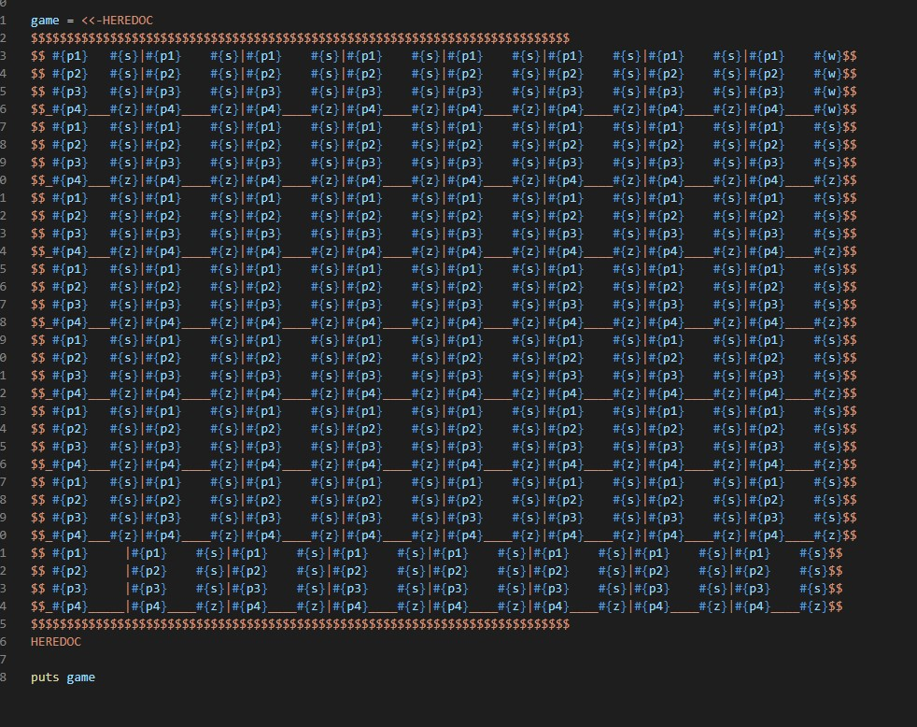
THANK YOU

